Slide 1
Module 5. Antiforensics
(part 3)

Slide 2
Topics
Encryption
Breaking Encryption
Hiding and Destroying Data

Slide 3
Antiforensics
Techniques to manipulate, erase, or obfuscate digital data to make its examination difficult, time-consuming, or virtually impossible

Slide 4
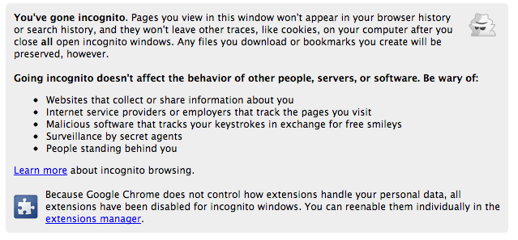
Private Browsing

Slide 5
Simple Privacy Methods
Weak, relatively ineffective
  Delete cookies
  Clear temporary internet files
  Clear history
  Changing filenames and extensions
  Burying files in unrelated directories
Real obstacles to forensic examiners
  Hiding files within other files (steganography)
  Encryption

Slide 6
Encryption

Slide 7
Protecting Secrets
We all need encryption for
  Credit card #s
  Passwords
  Medical data
Without encryption, the Web would be much less useful

Slide 8
Encryption Defined
Encryption converts data from plaintext (readable) to ciphertext (scrambled)
Algorithm is the mathematical process to encrypt and decrypt the message
Key is a value needed to encrypt and decrypt the data, usually a long random series of bits, sometimes derived from a password or passphrase

Slide 9
Caesar Cipher
Shift each letter forward one character
ABCDEFGHIJKLMNOPQRSTUVWXYZ
BCDEFGHIJKLMNOPQRSTUVWXYZA
CCSF --> DDTG

Slide 10
ROT13
Shift each letter forward 13 characters
ABCDEFGHIJKLMNOPQRSTUVWXYZ
NOPQRSTUVWXYZABCDEFGHIJKLM
CCSF --> PPFS → CCSF
Encrypting with ROT13 twice returns you to plaintext
Decryption algorithm = Encryption algorithm
Very weak—obfuscation, not encryption
Used in TypedURLS registry key, and for passwords in an early version of Netscape

Slide 11
Two kinds of
Cryptography
Asymmetric
Alice and Bob agree on a public-key cryptosystem
Bob sends Alice his public key
Alice encrypts her message using Bob’s public key and sends it to Bob
Bob decrypts Alice’s message using his private key
Symmetric
Alice and Bob agree on a cryptosystem
Alice and Bob agree on a key
Alice takes her plaintext message and encrypts it using the encryption algorithm and the key. This creates a ciphertext message
Alice sends the ciphertext message to Bob
Bob decrypts the ciphertext message with the same algorithm and key and reads it
http://fpt.edu.vn

Slide 12
Problems
Symmetric
Keys must be distributed in secret
If a key is compromised, Eve (eavesdropper) can
  decrypt any message
  pretend to be one of the parties
A network requires a great number of keys
Asymmetric
slow (~1000 times slower than the symmetric)
vulnerable to chosen-plaintext attacks

Slide 13
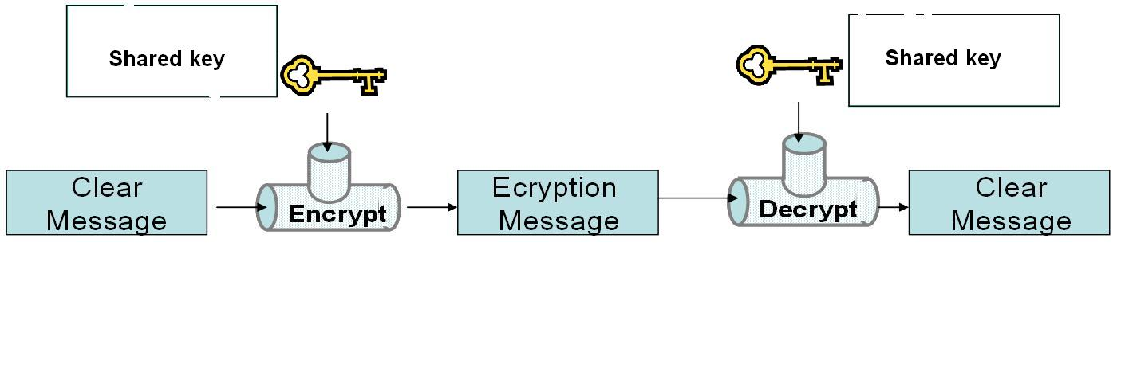
Symmetric Cryptography
One key encrypts and decrypts data

Slide 14
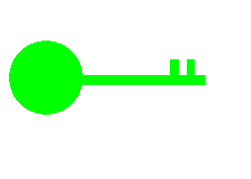

Asymmetric Cryptography Algorithms
Use two keys that are mathematically related
  Data encrypted with one key can be decrypted only with the other key
Another name for asymmetric key cryptography is public key cryptography
  Public key: known by the public
  Private key: known only by owner

Slide 15
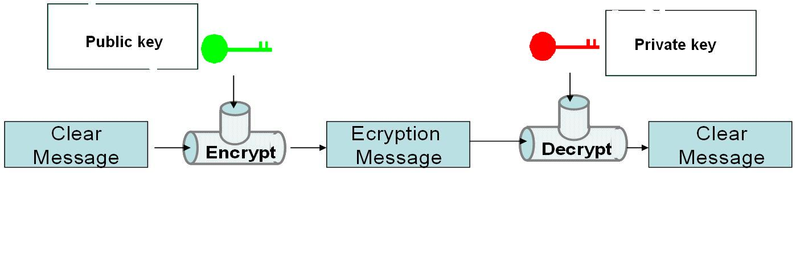
Asymmetric Cryptography

Slide 16
Popular Algorithms
Symmetric Encryption
  DES, 3DES, AES, Blowfish
Asymmetric Encryption
  RSA, ECC, ElGamal
The most secure algorithms are open-source
  Proprietary, secret algorithms are almost always insecure

Slide 17
Keys
A sequence of random bits
  The range of allowable values is called a keyspace
The larger the keyspace, the more secure the key
  8-bit key has 2⁸ = 256 values in keyspace
  24-bit key has 2²⁴ = 16 million values
  56-bit key has 2⁵⁶ = 7 x 10¹⁶ values
  128-bit key has 2¹²⁸ = 3 x 10³⁸ values

Slide 18
Brute Force Attack
In 1997 a 56-bit key was broken by brute force
  Testing all possible 56-bit keys
  Used 14,000 machines organized via the Internet
  It took 3 months

Slide 19
How Many Bits Do You Need?
How many keys could all the computers on Earth test in a year?
  Pentium 4 processor: 10⁹ cycles per second
  One year = 3 x 10⁷ seconds
  There are less than 10¹⁰ computers on Earth
    One per person
  10⁹ x 3 x 10⁷ x 10¹⁰ ⁼ 3 x 10²⁶ calculations
  128 bits should be enough (3 x 10³⁸ values)
    Unless computers get much faster, or someone breaks the algorithm

Slide 20
Practical Key Lengths
Private keys of 128 bits or longer are practically unbreakable at the moment
Public keys must be much longer
  2048 bits is the minimum recommended key size for RSA

Slide 21
Common Encryption Products
Windows 7: BitLocker and EFS
Apple: FileVault
Linux: TrueCrypt
Full Disk Encryption
  Much safer
  Does not encrypt a "boot partition"
File and Folder encryption

Slide 22
Encrypting File System (EFS)
In File Properties in Windows
Easy to use
Uses password to make a key
Part of the NTFS file system

Slide 23
BitLocker
Encrypts entire system partition
BitLocker To Go encrypts USB sticks
Requires Windows 7 Ultimate
  But it's available in all versions of Windows 8
Uses Trusted Platform Module chip
Best forensic method: seize the running, logged-in machine
  BitLocker is decrypted at that point

Slide 24
Apple FileVault
128 bit AES
Can encrypt whole drive
Keys can be backed up with Apple

Slide 25
TrueCrypt
Free open-source software
Runs on Linux, Mac, or Windows
Can encrypt part or all of a disk
Can use AES, Serpent,or Twofish
256-bit keys

Slide 26
Breaking Encryption

Slide 27
Breaking Passwords
Ask the user for it
Brute force attack
  Use every possible combination of characters
Dictionary attack
  Use passwords from a dictionary of common passwords
Reset Passwords
  Possible with administrator privileges or a hacking tool like UBCD
  Won't get you into EFS-encrypted files

Slide 28
Custom Dictionary
Acquire the hard disk (and RAM, if possible) of the evidence machine
Extract all strings
Use that as the password dictionary

Slide 29
Password Cracking Tools
Password Recovery Toolkit (PRTK) from AccessData
John the Ripper
Cain
Ophcrack
Hashcat (in Backtrack)

Slide 30
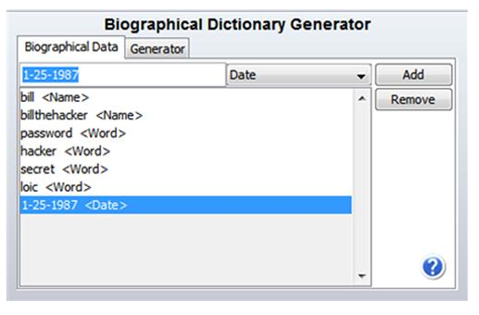
PRTK's Biographical Dictionary Generator

Slide 31
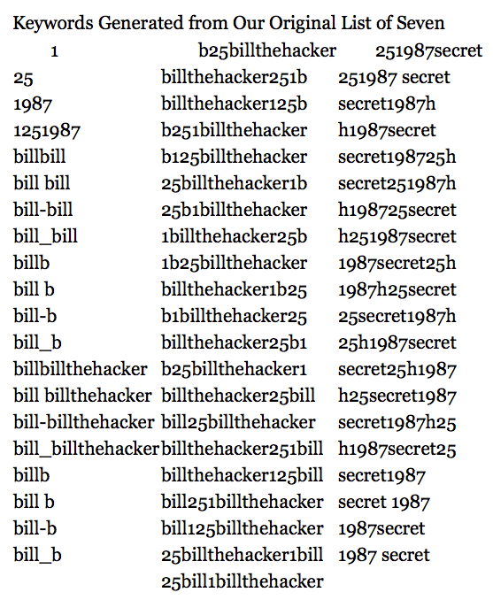

Slide 32
Breaking BitLocker
  Cold Boot Attack
    Freeze the RAM and recover the key
  Dissolve the TPM chip and recover the key with a microelectrode
Both are exotic, impractical attacks
User may have backed up the key in a Microsoft account

Slide 33
Steganography

Slide 34
Steganography , or stego for short, is another and very effective way to conceal data.
SearchSecurity.com defines steganography as “the hiding of a secret message within an ordinary message and the extraction of it at its destination” (TechTar-get,2000)
Two files comprise the finished stego file:
- Carrier files can be image files, video files, audio files, or word processing documents, just to name a few
- The embedded secret document is called the payload
http://fpt.edu.vn

Slide 35
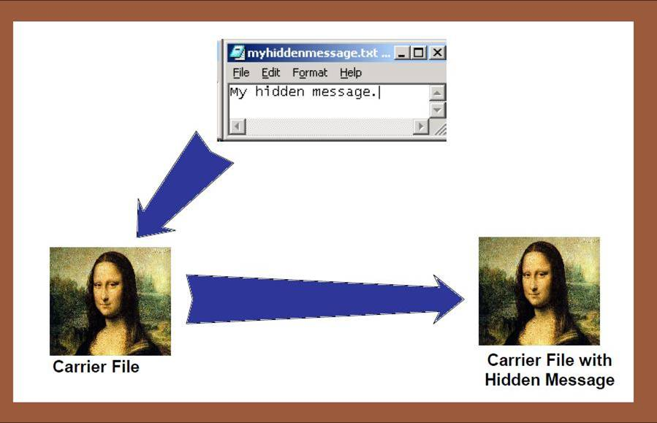
http://fpt.edu.vn

Slide 36
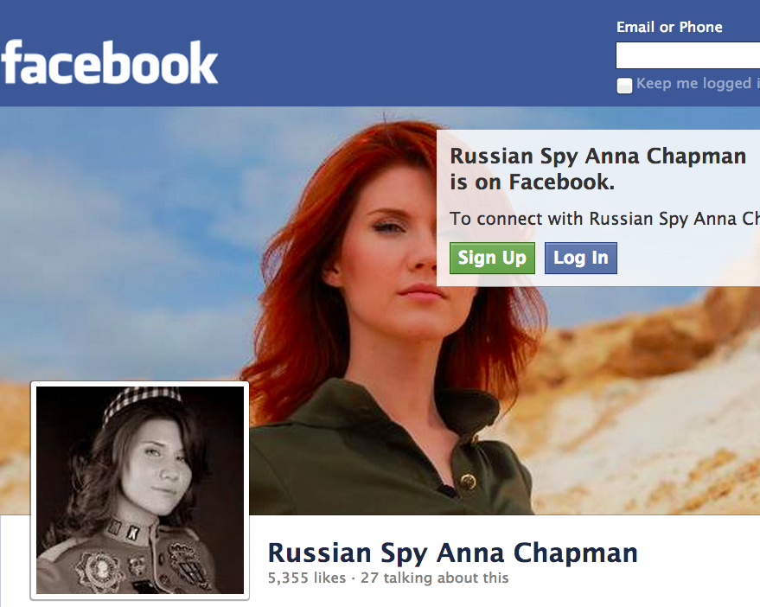
Steganography
Hiding a payload file inside another carrier file
Used by Osama Bin Laden and Russian spies

Slide 37
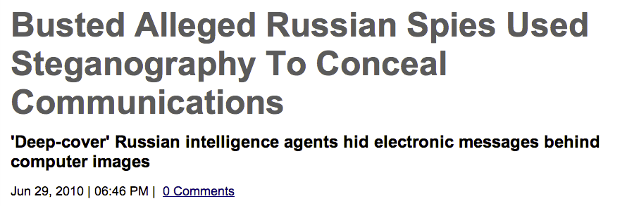
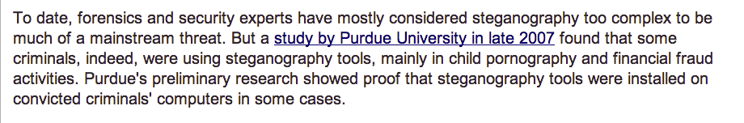

Slide 38
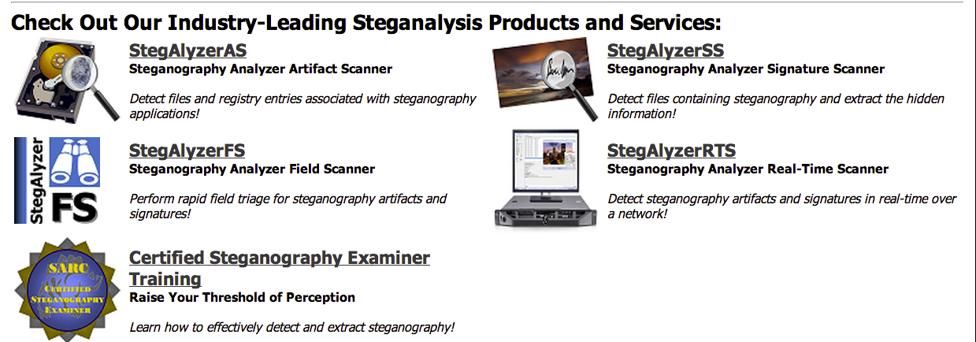
Stegan0graphy Detection Tools

Slide 39
Hiding and Destroying Data

Slide 40
Data Destruction
Drive Wiping
  Darik's Boot and Nuke (DBAN)
  Window Washer
  Evidence Eliminator
  Mac OS X Secure Erase
    Many others
Some erase whole disk, some only erase files or unused blocks, others erase only header & footer
Presence of these tools may be treated as evidence of guilt in court
  Especially if they were used just before evidence seizure

Slide 41
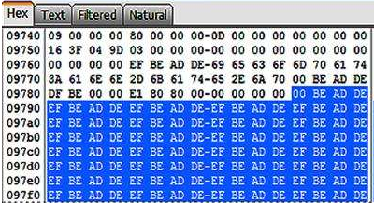
Some Wipers use Repeating Patterns
This is a sign of disk erasure

Slide 42
Defragmentation
Moves clusters to tidy up disk
Makes files open faster
Causes some sectors to be overwritten
Automatically performed weekly in Windows 7

Slide 43
Q&A
http://fpt.edu.vn

